Slide 1

SVKM’s Institute of Technology, Dhule department of Information Technology
Project Phase I Presentation
On
“Smart Guidance Stick”
Virtual Eye
By
20.Shruti Pramod Kothawade
40.Gaurav Dnyaneshwar Pawar
47.Mahek Faruk Sayyad
33.Jay Hemant Patil
Guide
“Mr. Mangesh Balpande”

Slide 2

Content
Group Details
Project Motivation
Problem Statement
Introduction
Approach / Technology Stack

Slide 3
Group Details
Project Title : Smart Guidance Stick – Third Eye
Project Group Members:
T2054491246053, Shruti Kothawade
T2054491246018, Gaurav Pawar
T2154491246027, Mahek Sayyad
T2054491246023, Jay Patil

Slide 4
Motivation
Blind people often face challenges in navigating their surroundings safely and independently.
This project aims to develop a smart guidance stick that is more affordable and user-friendly than the existing products on the market.
Significant Impact :
Avoid obstacles.
Navigate around unfamiliar terrain.
Find their way to familiar destinations through virtual assistant.
Emergency Contact.

Slide 5
Problem Statement
"Developing an affordable and user-friendly smart guidance stick for blind individuals to navigate their surroundings independently."

Slide 6
Introduction
Objective : Affordable and user-friendly technology solution.
Approach : Integrate variety of sensors, with a microcontroller to provide real-time obstacle detection.
Innovation : Unique sensor technology, virtual assistant, GPS and advanced algorithms set the project apart from existing solutions.
Feasibility : Secure and maintainable solution using existing programming languages and components.
Potential : Meaningful difference in the lives of visually impaired individuals and their families.

Slide 7
Start
no
Is device moving
Flow Diagram
Get the obstacle data
within 50 cm
yes
Obstacle’s data processing and matching with database
no
yes
Is obstacle data
match found
Obstacle name is unknown
Spell the obstacle name in voice message
Obstacle null
stop

Slide 8
Results :

Slide 9
References
[1] Md. Mostofa Shah, Md. Nasfikur R. Khan, Md. Raihan Ali Khan, Md. Mokarrom Hossain Plabon, M. Abdur Razzak. (2021). "A Cost-Effective Smart Walking Stick for Visually Impaired People," presented at 2021 6th International Conference on Communication and Electronics Systems (ICCES), IEEE.
[2] Namita Agarwal, Anosh Iyer, Sonalakshi Naidu, Snedden Rodrigues. (2015). "Electronic guidance system for the visually impaired - A framework," presented at 2015 International Conference on Technologies for Sustainable Development (ICTSD), IEEE.
[3] T Lavanya Narayani, M Sivapalanirajan, B Keerthika, M Ananthi, M Arunarani. (2021). "Design of Smart Cane with integrated camera module for visually impaired people," presented at 2021 International Conference on Artificial Intelligence and Smart Systems (ICAIS), IEEE.
[4] S Barathi Kanna, TR Ganesh Kumar, C Niranjan, S Prashanth, J Rolant Gini, M.E. Harikumar. (2021). "Low Cost Smart Navigation System for the Blind," presented at 2021 7th International Conference on Advanced Computing and Communication Systems (ICACCS), IEEE.
[5] D. M. L. V Dissanayake, R. G. M. D. R. P Rajapaksha, U. P Prabhashawara, S. A. D. S.P Solanga, J. A. D. C. Anuradha Jayakody. (2021). "Guide-Me: Voice authenticated indoor user guidance system," presented at 2021 IEEE 12th Annual Ubiquitous Computing, Electronics & Mobile Communication Conference (UEMCON), IEEE

Slide 10
Thank You

Slide 11
Introduction
Objective: Develop an affordable and user-friendly technology solution to assist visually impaired individuals in navigating their environment independently.
Approach: Integrate a variety of sensors, including ultrasonic and laser sensors, with a microcontroller to provide real-time obstacle detection.
Innovation: Unique sensor technology and advanced algorithms set the project apart from existing solutions.
Feasibility: Develop a modular, secure, and maintainable solution using existing programming languages and components.
Potential: The project has the potential to make a meaningful difference in the lives of visually impaired individuals and their families.

Slide 12
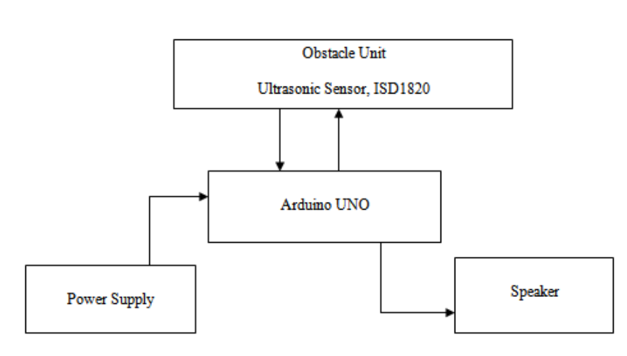
Block diagram

Slide 13
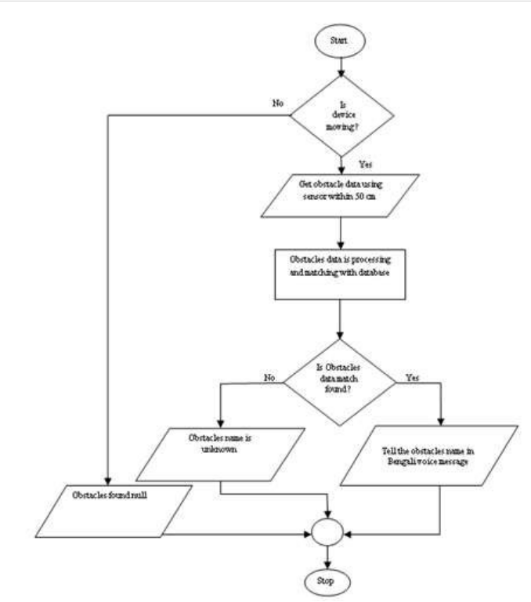
Flow diagram

